Slide 1
Default Entity Recognition
Lillian Xu

Slide 2
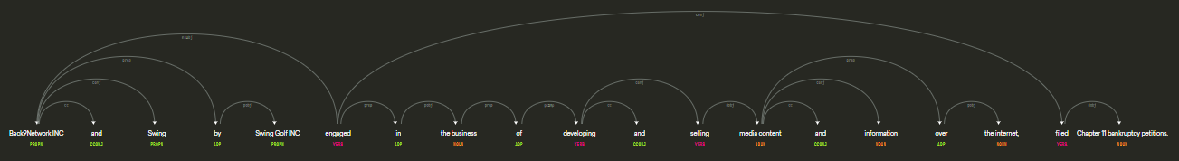
Previous Methodology
Light pre-processing
Spacy Parser to retrieve Named Entity
Spacy Parser automatically removes numbers in names. Spacy uses universal dependency structure, which is not good for longer sentences with clauses.

Slide 3
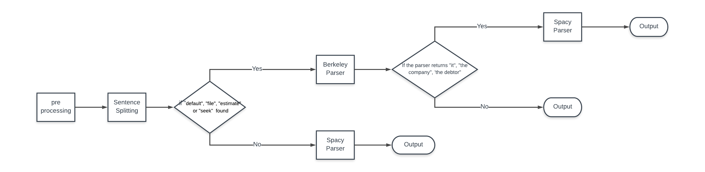
New Methodology
More pre processing
More accurate sentence splitting
Berkeley Parser better at sentences with clear structures
News sentences with verbs like Default, file, estimate, seek are usually very clear. Use Berkeley Parser to these sentences can achieve higher accuracy.

Slide 4
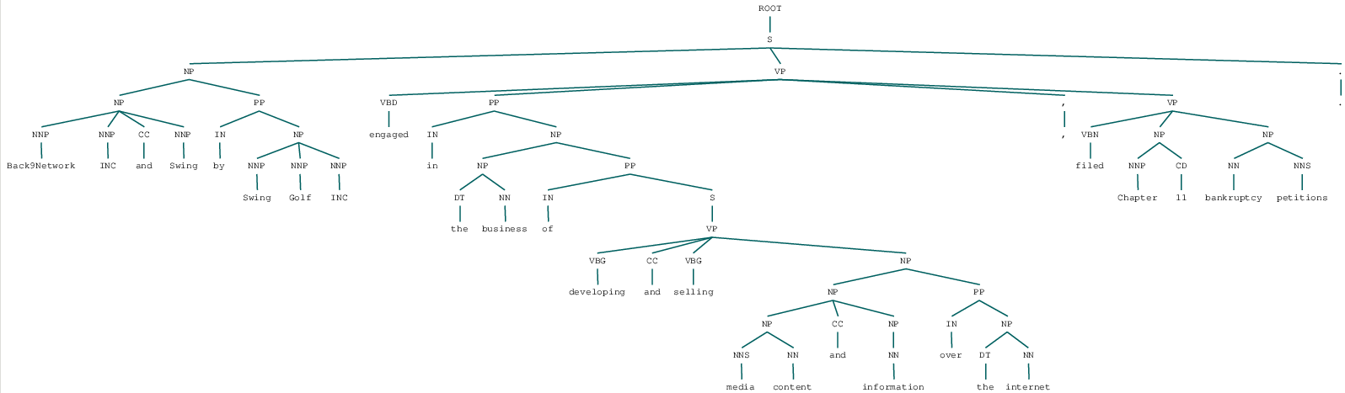
Parser Comparison: the Berkeley Parser
Highly sensible to sentence splitting
Easier extraction of Noun Phrases for longer sentences
Penn Treebank structure output
Written in Java, need to write Python wrapper

Slide 5
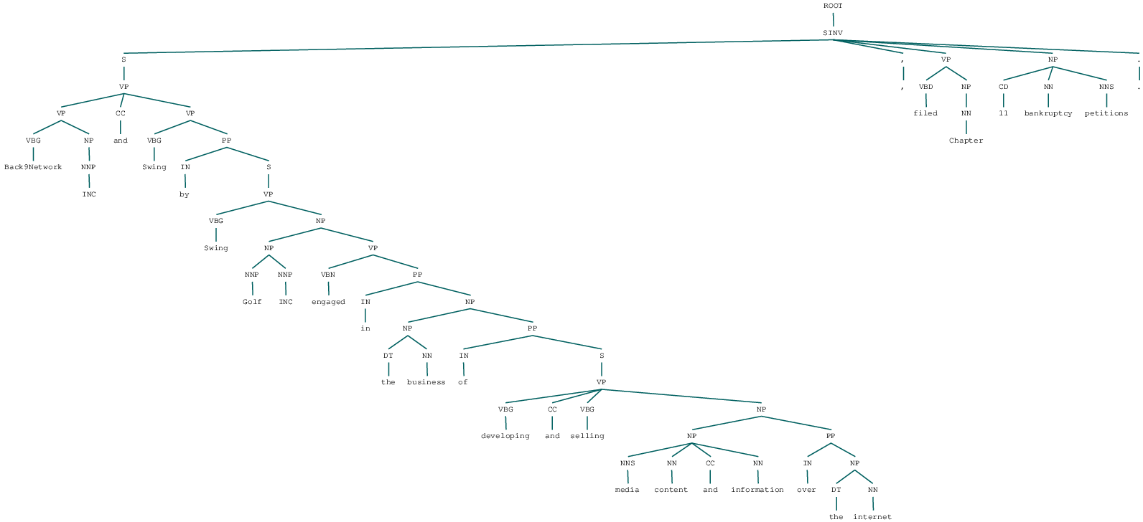
Parser Comparison: the Stanford Parser
Similar to the Berkeley Parser, very sensible to sentence splitting
Not as good in recognizing Noun Phrases
Penn Treebank structure output
Written in Java, coming with very user-friendly Python wrapper

Slide 6
Sentence Splitting
Using Regular Expressions package
Removing all the periods in abbreviations and names
Removing all the commas before and after abbreviations
Uppercased common words to lowercase, e.g. “Cannot” to “cannot”
Removing additional commas, spaces, dashes, etc.
Because all the Parsers think commas, periods, spaces and uppercases are signals to beginning/end of sentences.

Slide 7
Sentence Splitting Example
Back9Network Inc. and Swing by Swing Golf, Inc., engaged in the business of developing and selling media content and information over the internet, filed Chapter 11 bankruptcy petitions Bankr. D. Conn. Case Nos. 15-22192 and 15-22193, respectively on Dec. 23, 2015.
Removing all the periods in abbreviations and names
Removing all the commas before and after abbreviations
Switching cases
Removing dashes

Slide 8
Result
Out of 340 non-duplicated paragraphs, 273 are predicted correctly, compared to 236 from the old model.
~70% → ~80%

Slide 9
Extract Summarization for Yelp Reviews
Lillian Xu

Slide 10
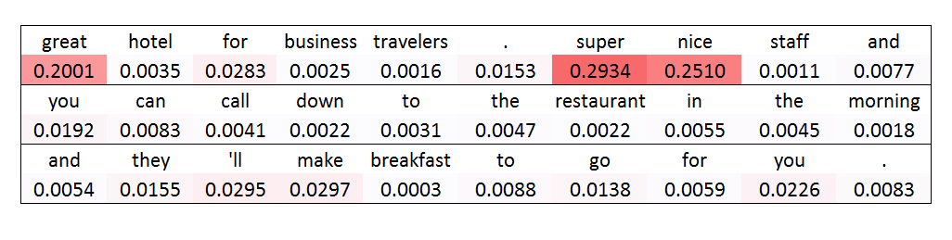
Problem Description
Extracted words with only strong sentiments but no context
great, super nice

Slide 11
Methodology
Parse the sentence into Penn Treebank structure
Assign each sub tree weight based on output from attention models
Add penalty to sub trees with more leaves
Extract the top 10 sub trees with most weights
If one sub tree is a sub sentence of another, choose the longer one and delete the shorter one
Keep the remaining distinct sub trees as final

Slide 12
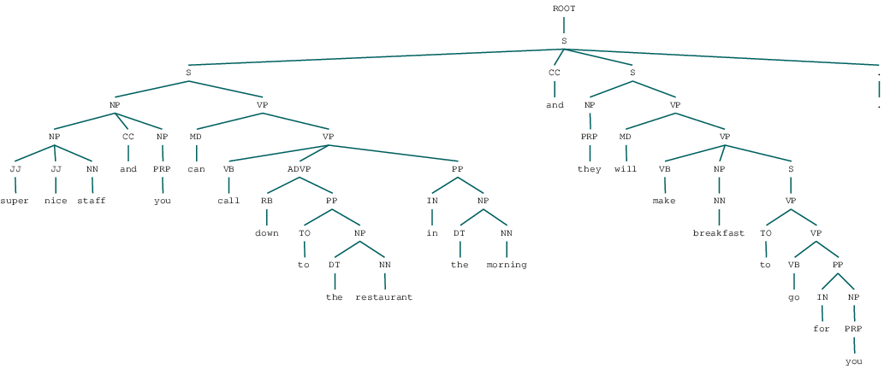
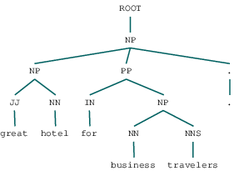
Step 1: Parse the sentences into Trees
great hotel for business travelers . super nice staff and you can call down to the restaurant in the morning and they will make breakfast to go for you .

Slide 13
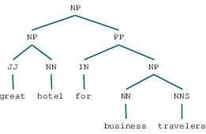
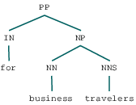

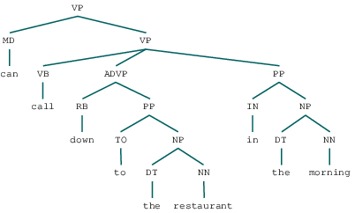
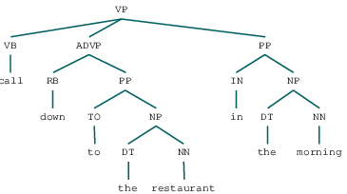
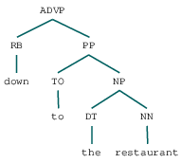
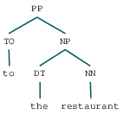
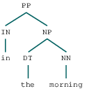
Step 2: Assign weights to sub trees
0.2335
0.0309
0.5440
0.0320
0.02411
0.0102
0.00851
0.01028

Slide 14
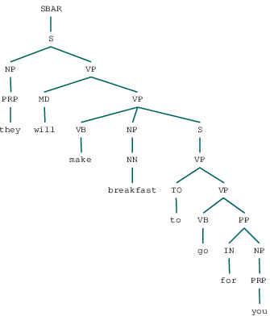
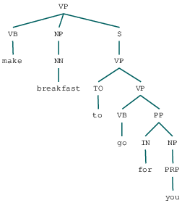
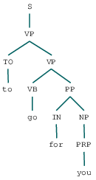
Step 3: Retrieve sub trees with top weights
0.005
0.006
0.0015
Extracted phrases are meaningful with both sentiments and context
super nice staff, great hotel for business travelers

Slide 15
© 2017 Moody’s Corporation, Moody’s Investors Service, Inc., Moody’s Analytics, Inc. and/or their licensors and affiliates (collectively, “MOODY’S”). All rights reserved.
CREDIT RATINGS ISSUED BY MOODY'S INVESTORS SERVICE, INC. AND ITS RATINGS AFFILIATES (“MIS”) ARE MOODY’S CURRENT OPINIONS OF THE RELATIVE FUTURE CREDIT RISK OF ENTITIES, CREDIT COMMITMENTS, OR DEBT OR DEBT-LIKE SECURITIES, AND MOODY’S PUBLICATIONS MAY INCLUDE MOODY’S CURRENT OPINIONS OF THE RELATIVE FUTURE CREDIT RISK OF ENTITIES, CREDIT COMMITMENTS, OR DEBT OR DEBT-LIKE SECURITIES. MOODY’S DEFINES CREDIT RISK AS THE RISK THAT AN ENTITY MAY NOT MEET ITS CONTRACTUAL, FINANCIAL OBLIGATIONS AS THEY COME DUE AND ANY ESTIMATED FINANCIAL LOSS IN THE EVENT OF DEFAULT. CREDIT RATINGS DO NOT ADDRESS ANY OTHER RISK, INCLUDING BUT NOT LIMITED TO: LIQUIDITY RISK, MARKET VALUE RISK, OR PRICE VOLATILITY. CREDIT RATINGS AND MOODY’S OPINIONS INCLUDED IN MOODY’S PUBLICATIONS ARE NOT STATEMENTS OF CURRENT OR HISTORICAL FACT. MOODY’S PUBLICATIONS MAY ALSO INCLUDE QUANTITATIVE MODEL-BASED ESTIMATES OF CREDIT RISK AND RELATED OPINIONS OR COMMENTARY PUBLISHED BY MOODY’S ANALYTICS, INC. CREDIT RATINGS AND MOODY’S PUBLICATIONS DO NOT CONSTITUTE OR PROVIDE INVESTMENT OR FINANCIAL ADVICE, AND CREDIT RATINGS AND MOODY’S PUBLICATIONS ARE NOT AND DO NOT PROVIDE RECOMMENDATIONS TO PURCHASE, SELL, OR HOLD PARTICULAR SECURITIES. NEITHER CREDIT RATINGS NOR MOODY’S PUBLICATIONS COMMENT ON THE SUITABILITY OF AN INVESTMENT FOR ANY PARTICULAR INVESTOR. MOODY’S ISSUES ITS CREDIT RATINGS AND PUBLISHES MOODY’S PUBLICATIONS WITH THE EXPECTATION AND UNDERSTANDING THAT EACH INVESTOR WILL, WITH DUE CARE, MAKE ITS OWN STUDY AND EVALUATION OF EACH SECURITY THAT IS UNDER CONSIDERATION FOR PURCHASE, HOLDING, OR SALE.
MOODY’S CREDIT RATINGS AND MOODY’S PUBLICATIONS ARE NOT INTENDED FOR USE BY RETAIL INVESTORS AND IT WOULD BE RECKLESS AND INAPPROPRIATE FOR RETAIL INVESTORS TO USE MOODY’S CREDIT RATINGS OR MOODY’S PUBLICATIONS WHEN MAKING AN INVESTMENT DECISION. IF IN DOUBT YOU SHOULD CONTACT YOUR FINANCIAL OR OTHER PROFESSIONAL ADVISER.
ALL INFORMATION CONTAINED HEREIN IS PROTECTED BY LAW, INCLUDING BUT NOT LIMITED TO, COPYRIGHT LAW, AND NONE OF SUCH INFORMATION MAY BE COPIED OR OTHERWISE REPRODUCED, REPACKAGED, FURTHER TRANSMITTED, TRANSFERRED, DISSEMINATED, REDISTRIBUTED OR RESOLD, OR STORED FOR SUBSEQUENT USE FOR ANY SUCH PURPOSE, IN WHOLE OR IN PART, IN ANY FORM OR MANNER OR BY ANY MEANS WHATSOEVER, BY ANY PERSON WITHOUT MOODY’S PRIOR WRITTEN CONSENT.
All information contained herein is obtained by MOODY’S from sources believed by it to be accurate and reliable. Because of the possibility of human or mechanical error as well as other factors, however, all information contained herein is provided “AS IS” without warranty of any kind. MOODY'S adopts all necessary measures so that the information it uses in assigning a credit rating is of sufficient quality and from sources MOODY'S considers to be reliable including, when appropriate, independent third-party sources. However, MOODY’S is not an auditor and cannot in every instance independently verify or validate information received in the rating process or in preparing the Moody’s publications.
To the extent permitted by law, MOODY’S and its directors, officers, employees, agents, representatives, licensors and suppliers disclaim liability to any person or entity for any indirect, special, consequential, or incidental losses or damages whatsoever arising from or in connection with the information contained herein or the use of or inability to use any such information, even if MOODY’S or any of its directors, officers, employees, agents, representatives, licensors or suppliers is advised in advance of the possibility of such losses or damages, including but not limited to: (a) any loss of present or prospective profits or (b) any loss or damage arising where the relevant financial instrument is not the subject of a particular credit rating assigned by MOODY’S.
To the extent permitted by law, MOODY’S and its directors, officers, employees, agents, representatives, licensors and suppliers disclaim liability for any direct or compensatory losses or damages caused to any person or entity, including but not limited to by any negligence (but excluding fraud, willful misconduct or any other type of liability that, for the avoidance of doubt, by law cannot be excluded) on the part of, or any contingency within or beyond the control of, MOODY’S or any of its directors, officers, employees, agents, representatives, licensors or suppliers, arising from or in connection with the information contained herein or the use of or inability to use any such information.
NO WARRANTY, EXPRESS OR IMPLIED, AS TO THE ACCURACY, TIMELINESS, COMPLETENESS, MERCHANTABILITY OR FITNESS FOR ANY PARTICULAR PURPOSE OF ANY SUCH RATING OR OTHER OPINION OR INFORMATION IS GIVEN OR MADE BY MOODY’S IN ANY FORM OR MANNER WHATSOEVER.
Moody’s Investors Service, Inc., a wholly-owned credit rating agency subsidiary of Moody’s Corporation (“MCO”), hereby discloses that most issuers of debt securities (including corporate and municipal bonds, debentures, notes and commercial paper) and preferred stock rated by Moody’s Investors Service, Inc. have, prior to assignment of any rating, agreed to pay to Moody’s Investors Service, Inc. for appraisal and rating services rendered by it fees ranging from $1,500 to approximately $2,500,000. MCO and MIS also maintain policies and procedures to address the independence of MIS’s ratings and rating processes. Information regarding certain affiliations that may exist between directors of MCO and rated entities, and between entities who hold ratings from MIS and have also publicly reported to the SEC an ownership interest in MCO of more than 5%, is posted annually at www.moodys.com under the heading “Investor Relations — Corporate Governance — Director and Shareholder Affiliation Policy.”
Additional terms for Australia only: Any publication into Australia of this document is pursuant to the Australian Financial Services License of MOODY’S affiliate, Moody’s Investors Service Pty Limited ABN 61 003 399 657AFSL 336969 and/or Moody’s Analytics Australia Pty Ltd ABN 94 105 136 972 AFSL 383569 (as applicable). This document is intended to be provided only to “wholesale clients” within the meaning of section 761G of the Corporations Act 2001. By continuing to access this document from within Australia, you represent to MOODY’S that you are, or are accessing the document as a representative of, a “wholesale client” and that neither you nor the entity you represent will directly or indirectly disseminate this document or its contents to “retail clients” within the meaning of section 761G of the Corporations Act 2001. MOODY’S credit rating is an opinion as to the creditworthiness of a debt obligation of the issuer, not on the equity securities of the issuer or any form of security that is available to retail investors. It would be reckless and inappropriate for retail investors to use MOODY’S credit ratings or publications when making an investment decision. If in doubt you should contact your financial or other professional adviser.
Additional terms for Japan only: Moody's Japan K.K. (“MJKK”) is a wholly-owned credit rating agency subsidiary of Moody's Group Japan G.K., which is wholly-owned by Moody’s Overseas Holdings Inc., a wholly-owned subsidiary of MCO. Moody’s SF Japan K.K. (“MSFJ”) is a wholly-owned credit rating agency subsidiary of MJKK. MSFJ is not a Nationally Recognized Statistical Rating Organization (“NRSRO”). Therefore, credit ratings assigned by MSFJ are Non-NRSRO Credit Ratings. Non-NRSRO Credit Ratings are assigned by an entity that is not a NRSRO and, consequently, the rated obligation will not qualify for certain types of treatment under U.S. laws. MJKK and MSFJ are credit rating agencies registered with the Japan Financial Services Agency and their registration numbers are FSA Commissioner (Ratings) No. 2 and 3 respectively.
MJKK or MSFJ (as applicable) hereby disclose that most issuers of debt securities (including corporate and municipal bonds, debentures, notes and commercial paper) and preferred stock rated by MJKK or MSFJ (as applicable) have, prior to assignment of any rating, agreed to pay to MJKK or MSFJ (as applicable) for appraisal and rating services rendered by it fees ranging from JPY200,000 to approximately JPY350,000,000.
MJKK and MSFJ also maintain policies and procedures to address Japanese regulatory requirements.

